Slide 1
Kernel Methods for Global Sensitivity Analysis (GSA)
John Barr and Herschel Rabitz
SAMO March 2022, Florida State University

Slide 2
Overview:
Main Point: Discuss Kernel methods are a “generalized” approach to GSA
Motivation: What do we mean by generalized?
Kernel method: How does it work and what properties make it generalized.
Conclusions and future directions
J. Barr SAMO 2022 1/10

Slide 3
Goals:
Develop GSA Methods that with wide-application; proposed methods should be…
1) Goal-oriented.
There are a lot of approaches to GSA, which is best?
Is the method tunable to the objective of the analysis?
2) Viable for complex systems.
Can the method handle different types of data? (Functional, non-numeric, etc.)
Does the method remain viable for high-dimensional settings?
J. Barr SAMO 2022 2/10

Slide 4
Kernel Approach
Let Y be the output domain. The function
$k:$ Y ×Y → ℝ
is said to be a kernel of Y if it is symmetric positive definite.
Theorem [Moore-Aronszajn]: If $k$ is a symmetric positive definite kernel on the non-empty set Y then it uniquely defines a Hilbert space H_{k} of ℝ-valued functions called the feature space.
J. Barr SAMO 2022 3/10

Slide 5
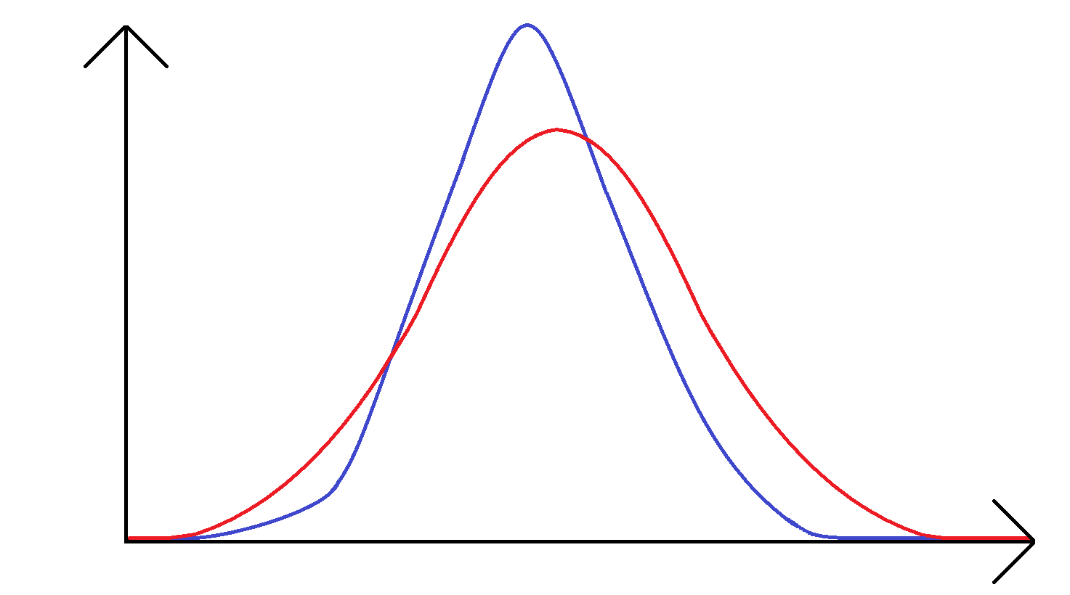
The Strategy
${\text{M}}_{\text{Y}}$
H_{k}
$${\text{ℙ}}_{Y|X_{R}}$$
$$μ_{Y|X_{R}}$$
${\text{ℙ}}_{Y}$
${\text{ℙ}}_{Y}$
$$μ_{Y}$$
$$Y$$
How: Kernel mean embedding [2],
${μ_{Y}(·)≔\text{𝔼}\text{[}\text{k}(·,y)]; y\sim \text{ℙ}}_{Y}$ and $μ_{Y}\text{∈}$H_{k}
[2] Gretton et. al., 2006.
J. Barr SAMO 2022 4/10

Slide 6
The Strategy
${\text{M}}_{\text{Y}}$
H_{k}
$${\text{ℙ}}_{Y|X_{R}}$$
$$μ_{Y|X_{R}}$$
${\text{ℙ}}_{Y}$
${\text{ℙ}}_{Y}$
MMD
$$μ_{Y}$$
$$Y$$
How: Maximum mean discrepancy (MMD) [2],
$$MMD\left[{\text{ℙ}}_{Y},{\text{ℙ}}_{Y|X_{R}},k\right]={\left\|μ_{Y}−μ_{Y|X_{R}}\right\|}_{{\text{H}}_{k}}$$
[2] Gretton et. al., 2006.
J. Barr SAMO 2022 4/10

Slide 7
Calculation
Definition [MMD]: The MMD can equivalently expressed in terms of the kernel function,
$${MMD}^{2}\left[{\text{ℙ}}_{Y},{\text{ℙ}}_{Y|X_{R}},k\right]=\text{𝔼}\left[k\left(y_{1},y_{1}^{′}\right)\right]+\text{𝔼}\left[k\left(y_{2},y_{2}^{′}\right)\right]−2\text{𝔼}\left[k\left(y_{1},y_{2}\right)\right]$$
Where $y_{1},y_{1}^{′}\sim {\text{ℙ}}_{Y}$ and $y_{2},y_{2}^{′}{\sim \text{ℙ}}_{Y|X_{R}}$.
J. Barr SAMO 2022 5/10

Slide 8
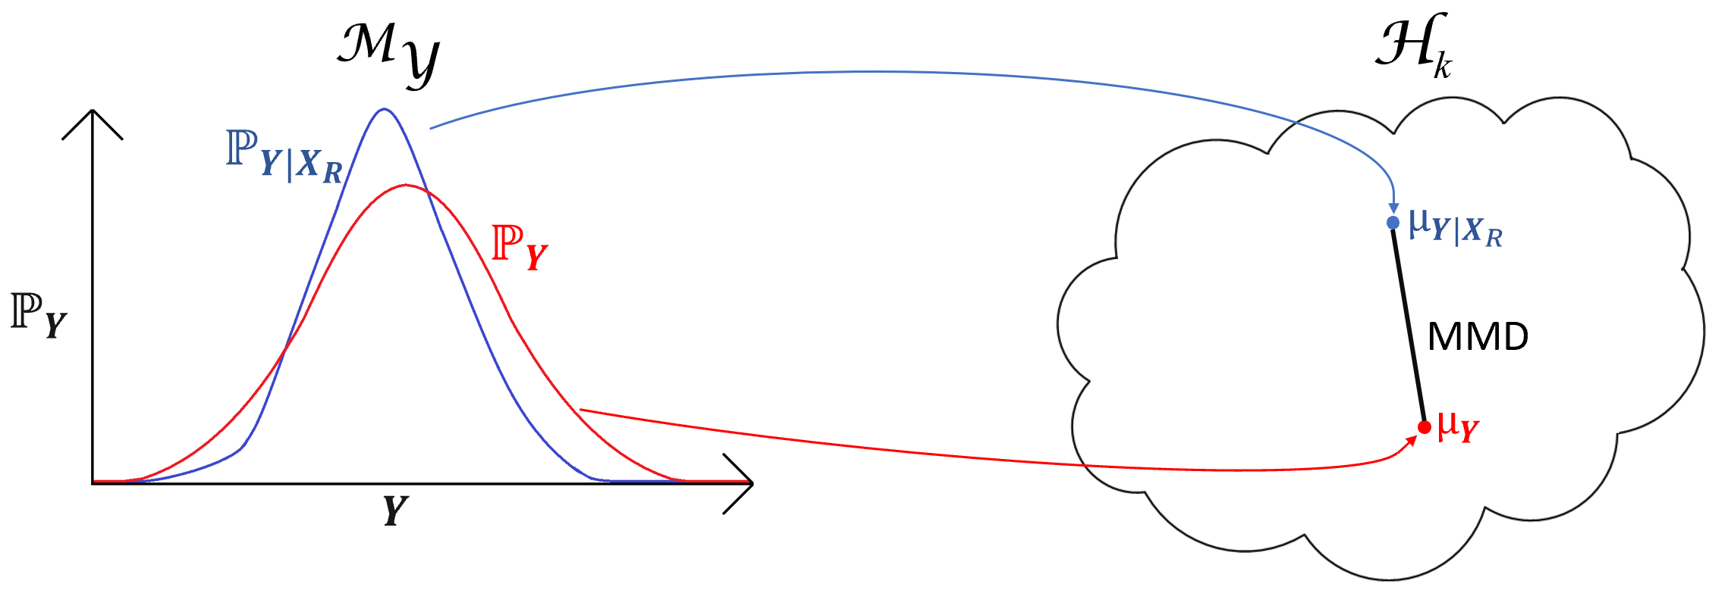
β^{k} -Indicators
$$β_{R}^{k}=\text{𝔼}\left[\text{d}\text{(}{\text{ℙ}}_{Y} \text{, }{\text{ℙ}}_{Y|X_{R}}\text{)}\right]$$
$\text{d}\text{(}{\text{ℙ}}_{Y} \text{, }{\text{ℙ}}_{Y|X_{R}}\text{)}$ = ${MMD}^{2}\left[{\text{ℙ}}_{Y} \text{, }{\text{ℙ}}_{Y|X_{R}},k\right]$
Key Result: Can choose $k$ to tailor a β^{k} –Indicator to the specific output distribution features of interest.
Examples of other GSA measures:
Variance-Based Indices (Moment Dependent)
Energy Distance Measures (Moment-Independent)
J. Barr SAMO 2022 6/10

Slide 9
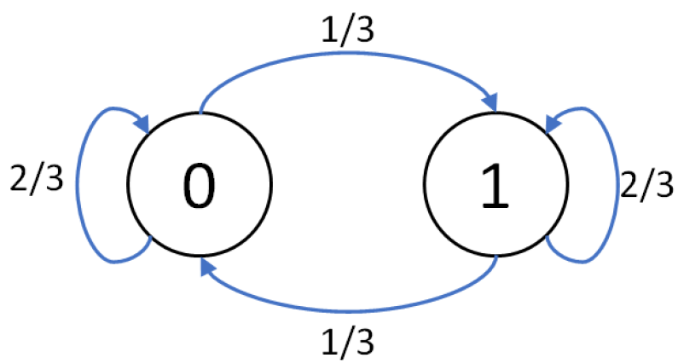
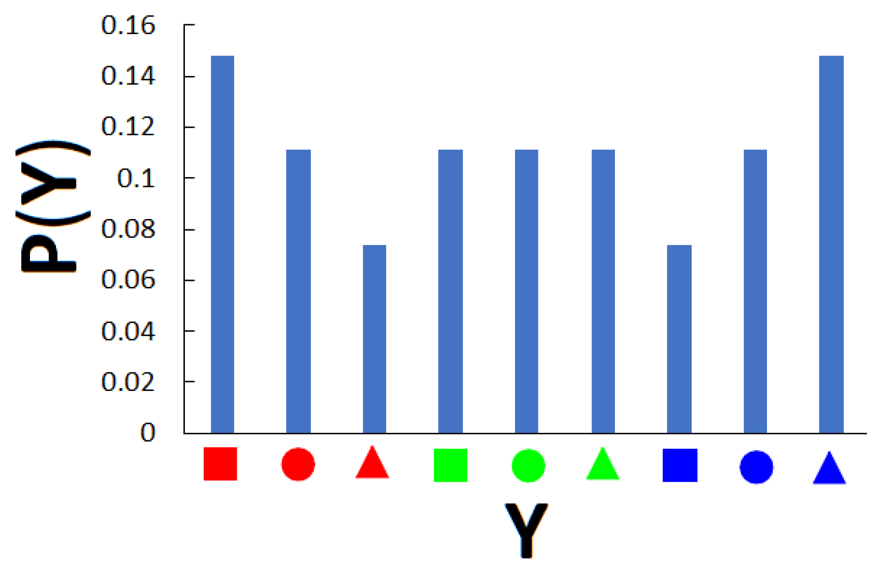
Example: Toy Problem
Inputs: 4 digit binary strings; X= X₁X₂X₃X_{4,} where X_{i} = $\left\{0,1\right\}$
Input Generation: Strings randomly generated as a Markov chain
X₁
X₂
X₃
X₄
β^{k} –Indicators:
$α_{1}$, weights indicator to color marginal
$α_{2}$, weights indicator to shape marginal
$α_{3}$, weights indicator to joint information
[1] Barr, John, and Herschel Rabitz. "A Generalized Kernel Method for Global Sensitivity Analysis." SIAM/ASA JUQ (2022)
J. Barr SAMO 2022 7/10

Slide 10
Handling Complexity
Minimal assumptions: Works for different data types!
The output domain is non-empty and a kernel function exists
Implicit assumption: Input space is a regular conditional probability space
Dimensionality: If Y = ℝ^{m}, then mean embedding estimator converges in probability at a rate $O\left(\frac{1}{\sqrt{N}}\right)$ is independent of the dimensionality, m.[2]
Key Result: Viable regardless of output complexity (in terms of dimensionality or data type).
Input complexity?
Algorithmic Question
Common Rationale [3]:
$$β_{R}^{k}=\text{𝔼}\left[\text{d}\text{(}{\text{ℙ}}_{Y} \text{, }{\text{ℙ}}_{Y|X_{R}}\text{)}\right]$$
[2] Gretton et. al., 2006.
[3] Borgonovo et. al. 2016.
[4] Da Veiga et. al. 2016.
J. Barr SAMO 2022 8/10

Slide 11
Conclusions
Kernel methods are goal oriented.†
2) Kernel methods are computationally feasible for more complex systems.†
3) Kernel methods are viable for non-scalar systems.
†Initial Success, but on-going research areas in kernel GSA
^{Goal → Kernel}
^{Kernel ← Goal}
J. Barr SAMO 2022 9/10

Slide 12
References:
[1] Barr, John, and Herschel Rabitz. "A Generalized Kernel Method for Global Sensitivity Analysis." SIAM/ASA Journal on Uncertainty Quantification 10.1 (2022): 27-54.
[2] Gretton, A., Borgwardt, K., Rasch, M., Schölkopf, B., & Smola, A. "A kernel method for the two-sample-problem." Advances in neural information processing systems 19 (2006).
[3] Borgonovo, Emanuele, Gordon B. Hazen, and Elmar Plischke. "A common rationale for global sensitivity measures and their estimation." Risk Analysis 36.10 (2016): 1871-1895.
[4] Da Veiga, Sébastien. "Kernel-based ANOVA decomposition and Shapley effects--Application to global sensitivity analysis." arXiv preprint arXiv:2101.05487 (2021).
J. Barr SAMO 2022 10/10

Slide 13
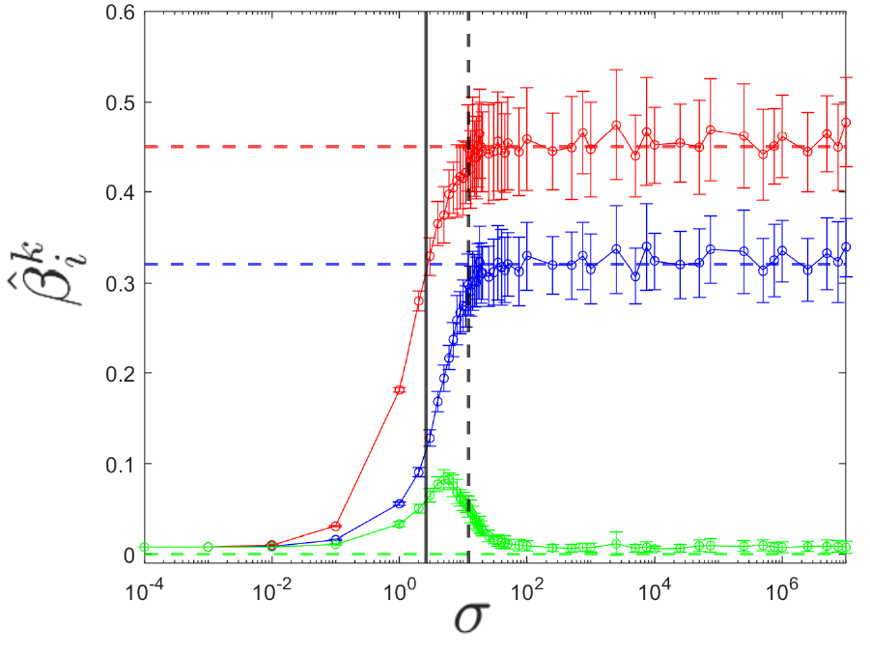
Reference Slide: Hyperparameter
Ishigami test-case:
X₂
X₁
X₃
Heuristic:
Solid = median distance between points of the output sample.
Dash = Square root of variance

Slide 14
Handling Complexity: Input Complexity
Calculation Procedure? Numerical/algorithmic question regarding [3]: $\text{𝔼}\text{[}\text{d}\text{(}{\text{ℙ}}_{Y}\text{ , }{\text{ℙ}}_{Y|X_{R}}\text{)]}$
Double-loop procedures
Pick-Freeze
Binning Procedures
Nearest-Neighbor Approach
Requires conditional sampling, a lot of simulation calls [1,4].
Works from a given unconditional data set,
but scales poorly for higher-order indices [1].
Works from a given unconditional data set,
and avoids curse-of-dimensionality [4].
Future Direction: An on-going area of research, but there has been some promising results.
[1] Barr et. al.; [4] Da Veiga.

